Slide 1

CAR PARKING
SYSTEM
-DIGIWARE
END TERM PROJECT PRESENTATION

Slide 2



State Transition Diagram
1000/0
State 0
S1
Initial State
x110/1
10x0/0
State 1
Car has arrived; Ask for password/worng password
State 2
S0
S2
Right password: The Gate opens.
reset
00x0/0
State 3
The car has passed and the Gate closes.
S3
x011/1
xx10/0
abcd/e : Entrance sensor1-Entrance sensor2-Password-Exit Sensor/Gate

Slide 3
State Transition Table
RESET | PRESENT STATE | INPUT | NEXT STATE | OUTPUT
1 | XX | XXXX | 00 | 0
0 | 00 | 10X0 | 01 | 0
0 | 01 | 00X0 | 00 | 0
0 | 01 | X110 | 10 | 1
0 | 01 | 1000 | 01 | 0
0 | 10 | X011 | 11 | 1
0 | 11 | X010 | 00 | 0
STATE 0 = 00
STATE 1 = 01
STATE 2 = 10
STATE 3 = 11
INPUT :
Entrance_Sensor1-Entrance_Sensor2-Password-Exit_sensor
OUTPUT:
Gate

Slide 4
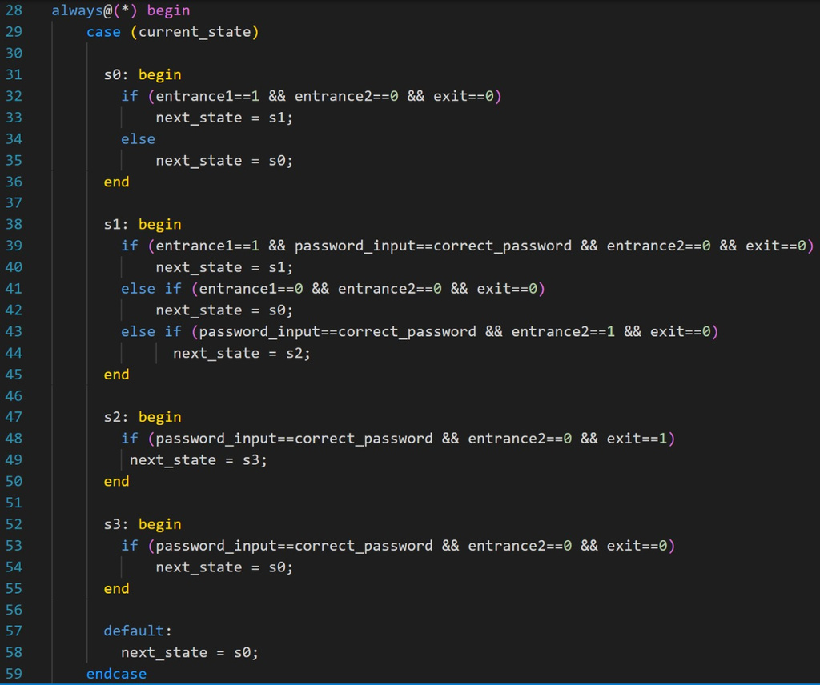
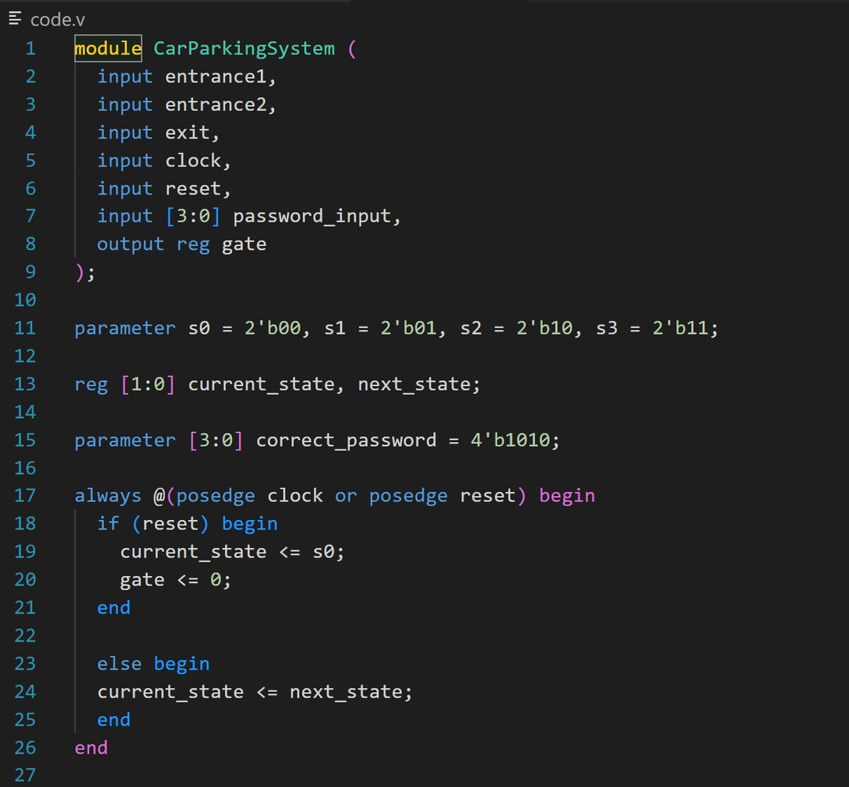
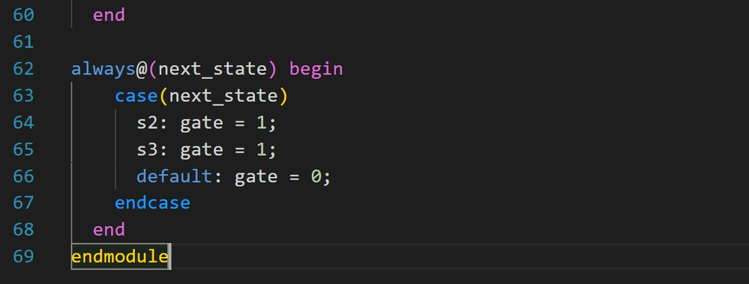
the code

Slide 5
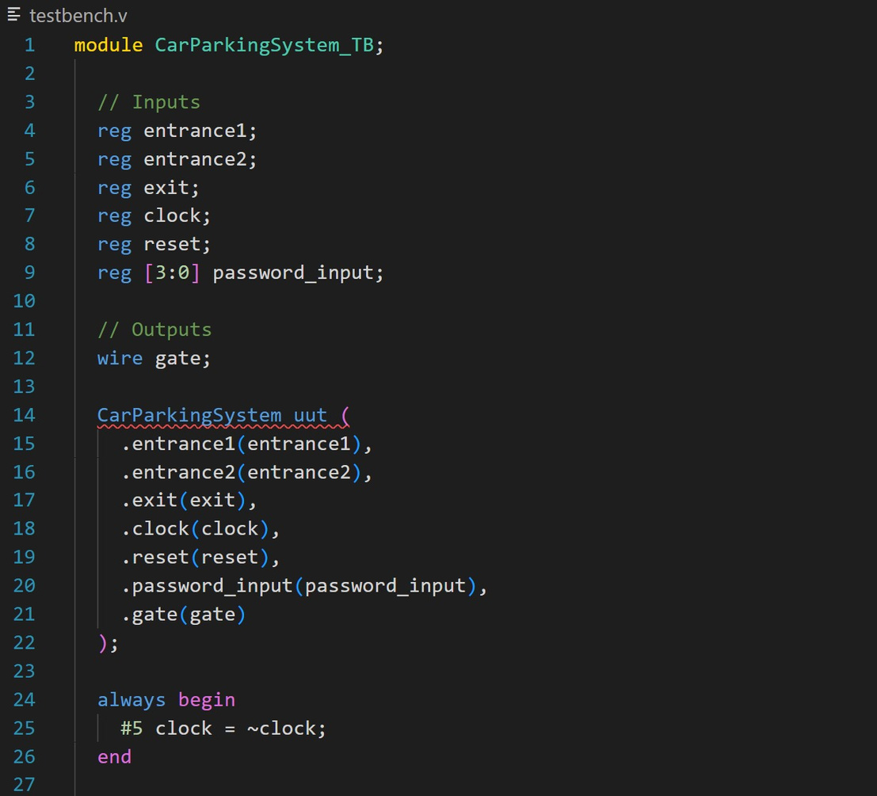
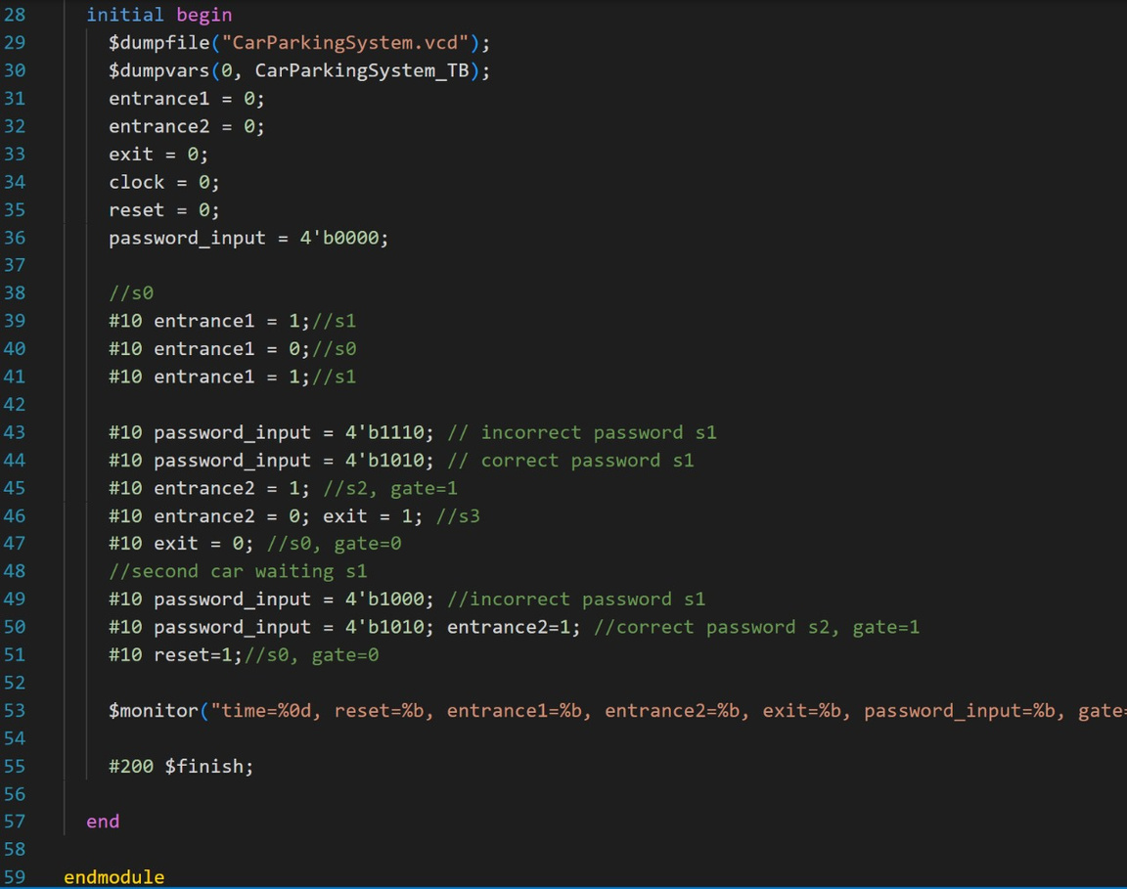
the testbench

Slide 6
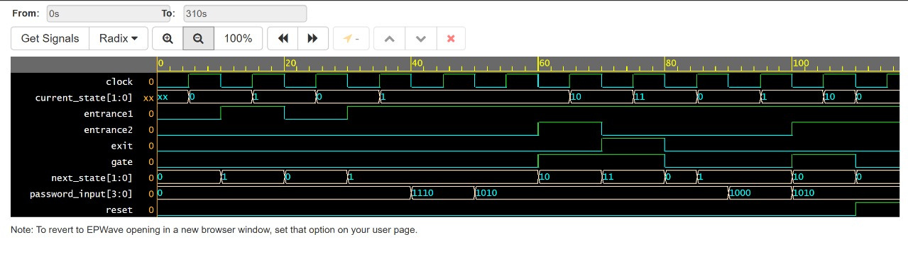
Simulation

Slide 7
Our Team
Thogiti
Amar
Sathwik
Anany
Dev
Choudhary
Gude
Dayana
Rachit
Jain
Bandaru
Venkata
Sritan

Slide 8
THANK YOU

